Slide 1
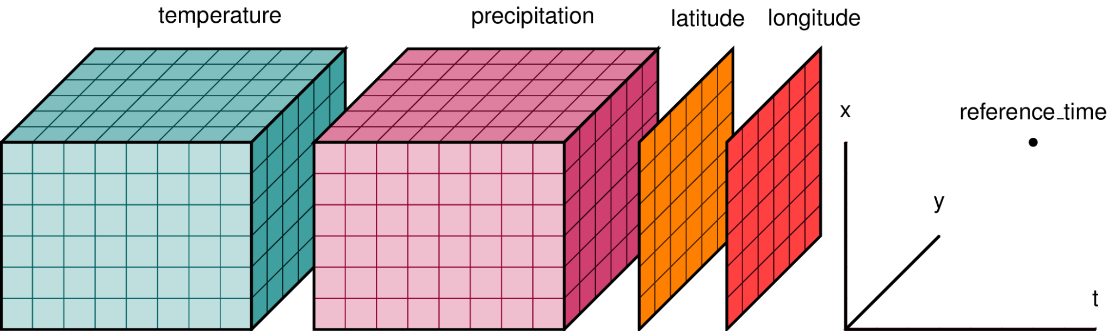
Introduction to NetCDF

Slide 2
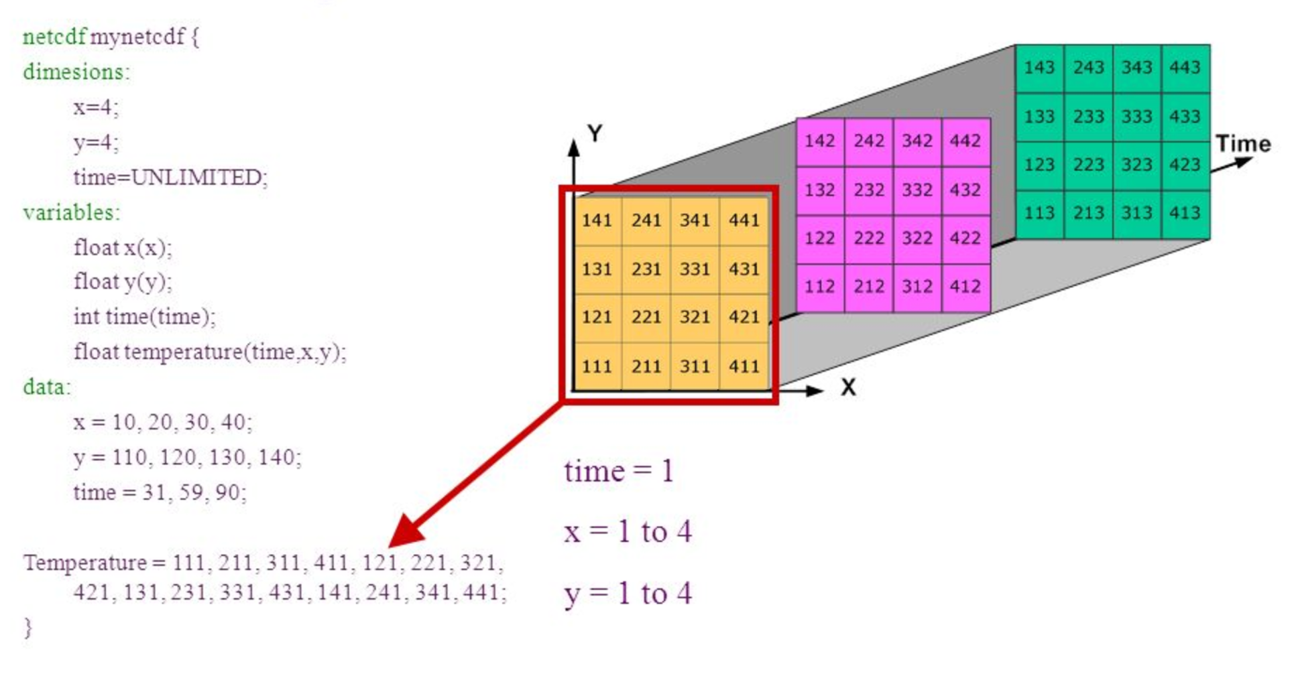
What is Netcdf?
Definition of NetCDF: NetCDF stands for Network Common Data Form.
Purpose: NetCDF is a file format designed for storing and sharing scientific data in a self-describing and machine-independent manner.
Self-Describing: NetCDF files include information about the data they contain, making them self-describing and reducing the need for external documentation.
Hierarchical Structure: NetCDF files can contain multiple dimensions, variables, and attributes, allowing for organized data representation.

Slide 3
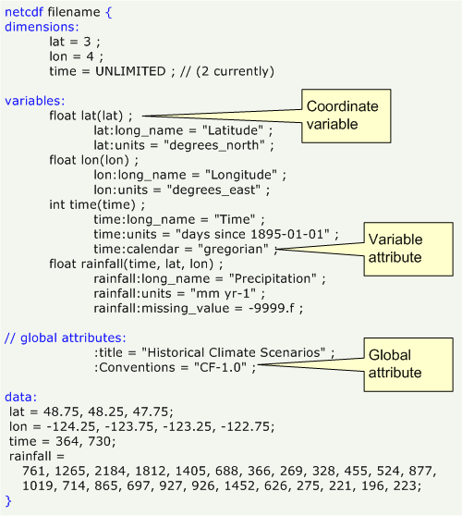
Common Applications of NetCDF
Multidisciplinary: NetCDF is used across various scientific domains, including meteorology, oceanography, geophysics, and more.
Data Preservation: NetCDF files aid in preserving data integrity and consistency over time, ensuring long-term usability.
Collaboration: NetCDF's standardized format promotes data sharing and collaboration among researchers and institutions.

Slide 4
NetCDF Conventions
Convention: A convention is a set of agreed-upon rules and standards for how data is described within a NetCDF file. It specifies how to define variables, their units, dimensions, and other metadata, making the data's meaning clear.
CF-convention: Developed for climate and forecast models but now widely used in other geosciences.
Role: It defines rules for metadata like:
standard_name: A precise, human-readable name for a variable (e.g.,sea_water_temperature).
units: The units of a variable (e.g., meters, Kelvin).

Slide 5
Why convention is important?
Standardization: Without conventions, each data provider would create their own unique way of describing data, making it difficult to share and use.
Clarity: Conventions provide a universal language for scientific data, ensuring consistency and reducing ambiguity.
Tool Support: Many software tools, such as those used for climate modeling and conventions. data visualization, are built to understand and generate data adhering to CF.

Slide 6
Common Tools
NetCDF built-in tools
e.g. ncdump -h netcdf_file.nc
CDO (Climate Data Operators)
A collection of command-line operators for climate and forecast model data
Works with NetCDF, GRIB, and other formats
e.g. cdo monmean input.nc output_monmean.nc
NCO (NetCDF Operators)
A suite of command-line tools for editing, analyzing, and manipulating NetCDF files
ncks, ncrename, ncatted, ncap2, ncra, ncea
e.g. ncks -v temperature,time input.nc subset.nc

Slide 7
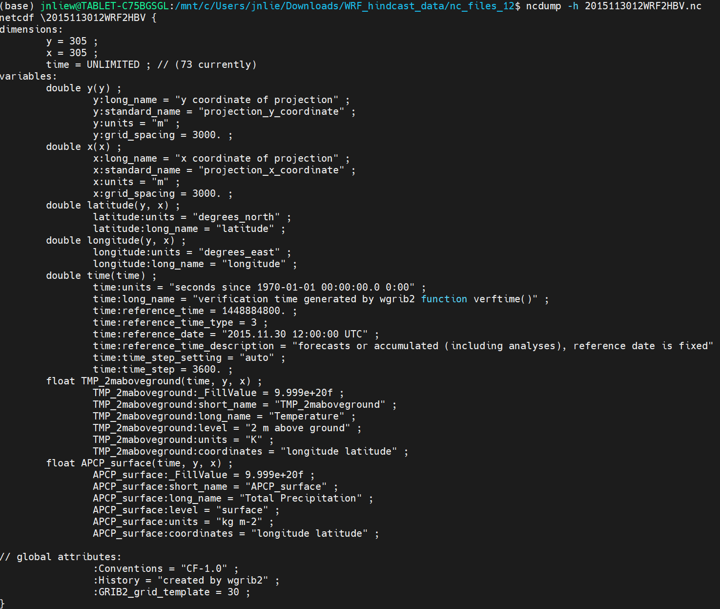
The received files
Is the file CF-compliant ?

Slide 8
Thank you

